Slide 1
Compulsory Education in the Universal Declaration of Human Rights
The drafting of Article 26

Slide 2
Universal Declaration of Human Rights - Article 26
„Elementary education shall be compulsory.“
Convention on the Rights of the Child - Article 28
„Make primary education compulsory and available free to all.“

Slide 3
Article 26 (UDHR)
1. Everyone has the right to education. Education shall be free, at least in the elementary and fundamental stages. Elementary education shall be compulsory. Technical and professional education shall be made generally available and higher education shall be equally accessible to all on the basis of merit.
2. Education shall be directed to the full development of the human personality and to the strengthening of respect for human rights and fundamental freedoms. It shall promote understanding, tolerance and friendship among all nations, racial or religious groups, and shall further the activities of the United Nations for the maintenance of peace.
3. Parents have a prior right to choose the kind of education that shall be given to their children.

Slide 4
Article 26 (UDHR)
1. Everyone has the right to education. Education shall be free, at least in the elementary and fundamental stages. Elementary education shall be compulsory. Technical and professional education shall be made generally available and higher education shall be equally accessible to all on the basis of merit.
2. Education shall be directed to the full development of the human personality and to the strengthening of respect for human rights and fundamental freedoms. It shall promote understanding, tolerance and friendship among all nations, racial or religious groups, and shall further the activities of the United Nations for the maintenance of peace.
3. Parents have a prior right to choose the kind of education that shall be given to their children.
Access
Content
Responsibility

Slide 5
Article 26 (UDHR)
1. Everyone has the right to education. Education shall be free, at least in the elementary and fundamental stages. Elementary education shall be compulsory. Technical and professional education shall be made generally available and higher education shall be equally accessible to all on the basis of merit.
2. Education shall be directed to the full development of the human personality and to the strengthening of respect for human rights and fundamental freedoms. It shall promote understanding, tolerance and friendship among all nations, racial or religious groups, and shall further the activities of the United Nations for the maintenance of peace.
3. Parents have a prior right to choose the kind of education that shall be given to their children.

Slide 6
Article 26 (UDHR)
The drafting procedure
The bodies involved
The drafts
The arguments

Slide 7
The bodies involved

Slide 8
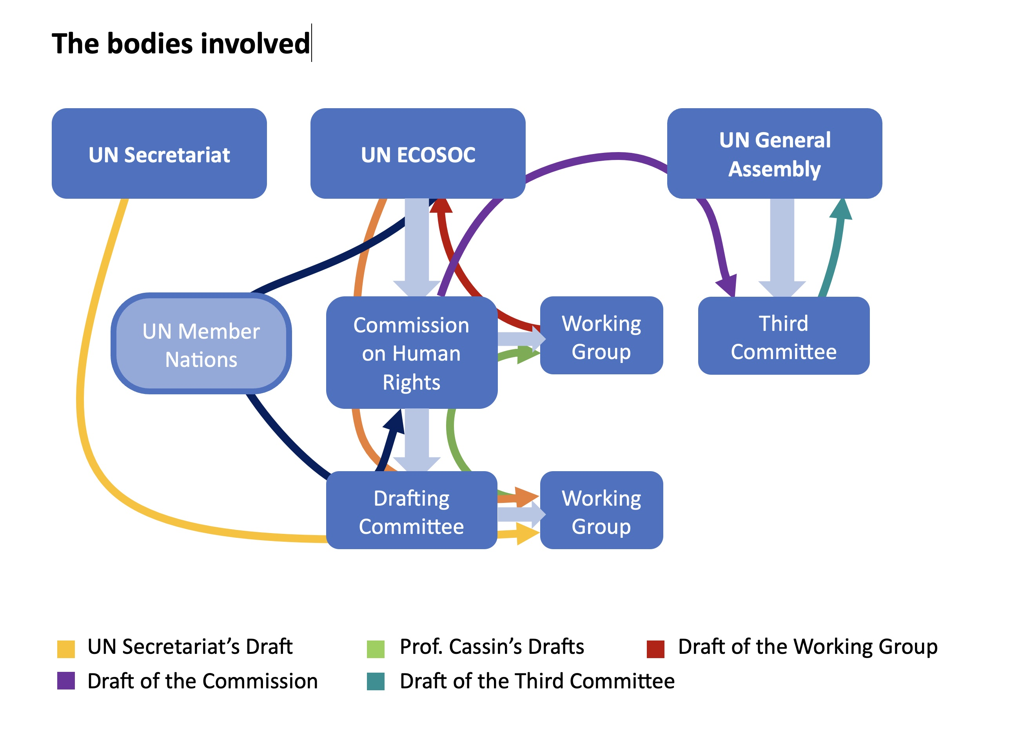

Slide 9
The drafts

Slide 10
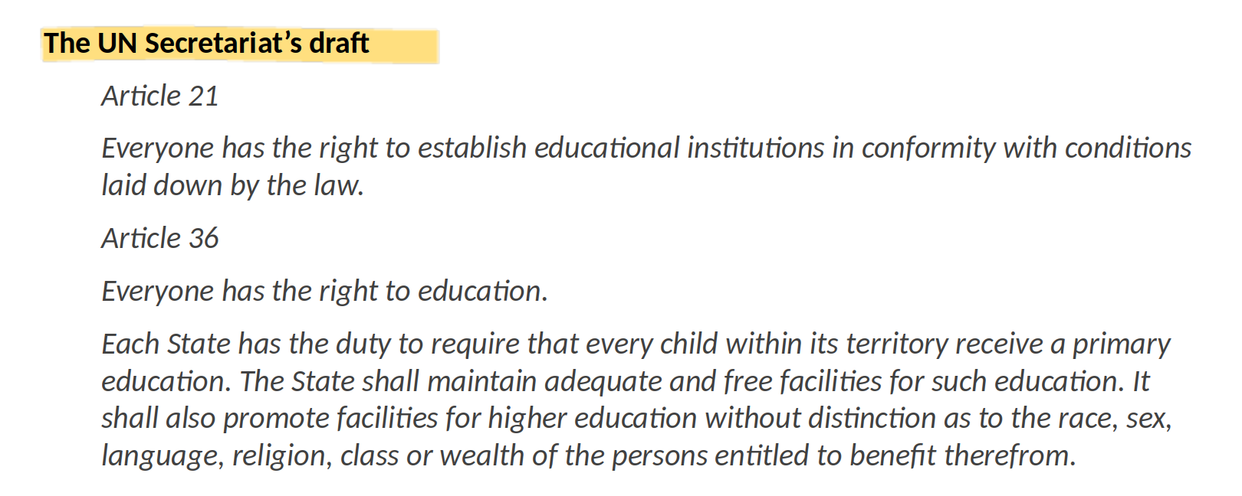

Slide 11
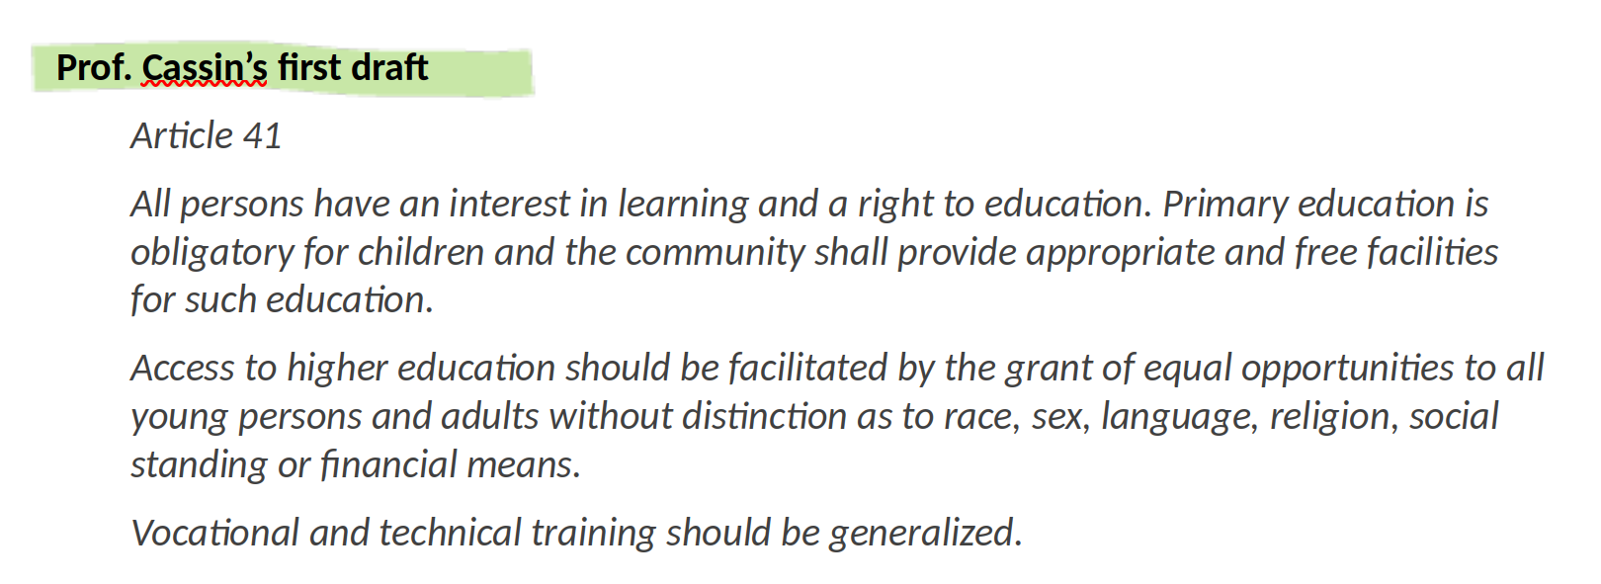

Slide 12
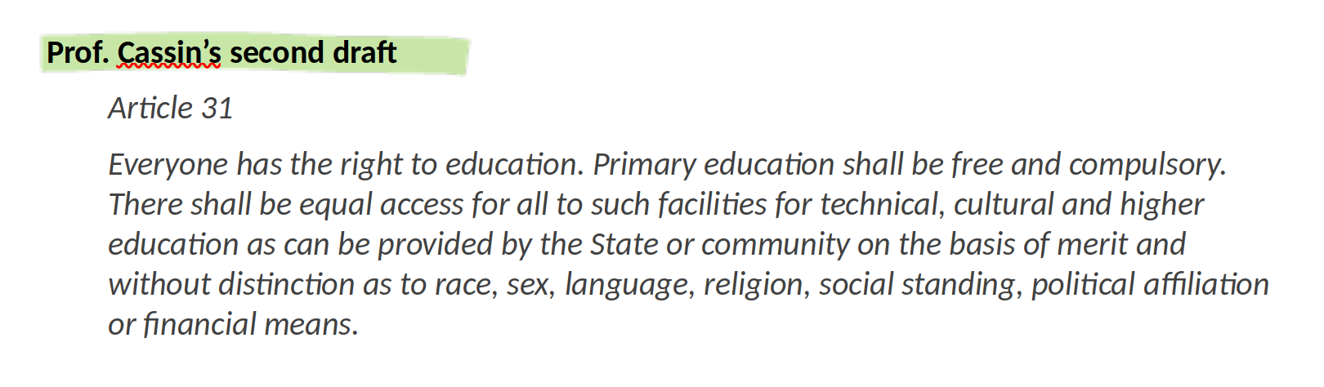

Slide 13
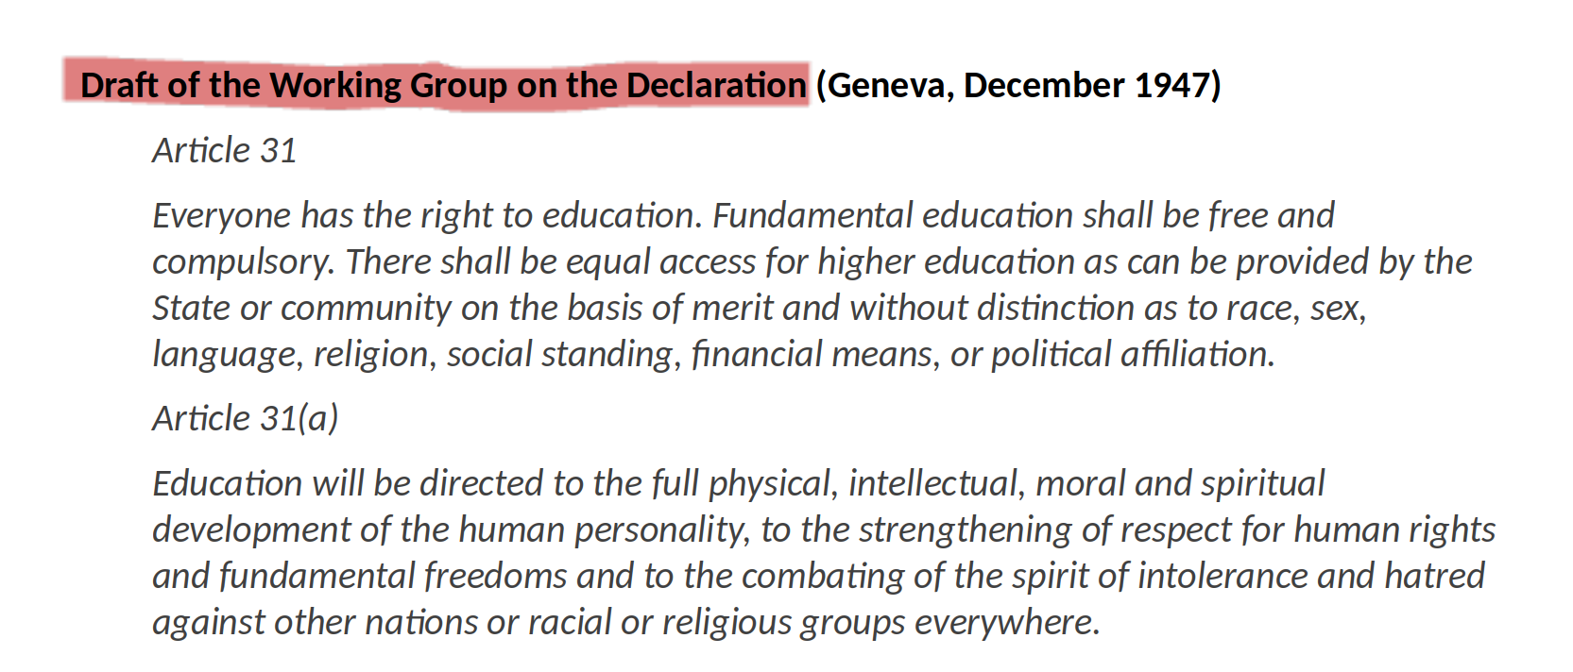

Slide 14
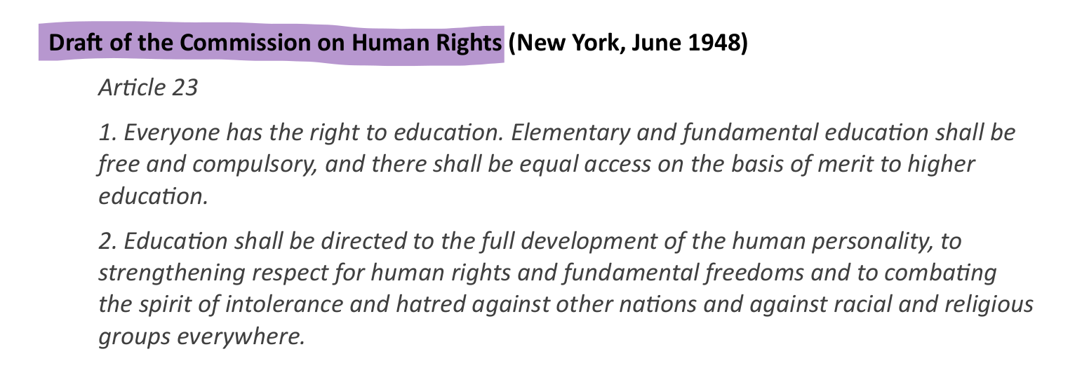

Slide 15
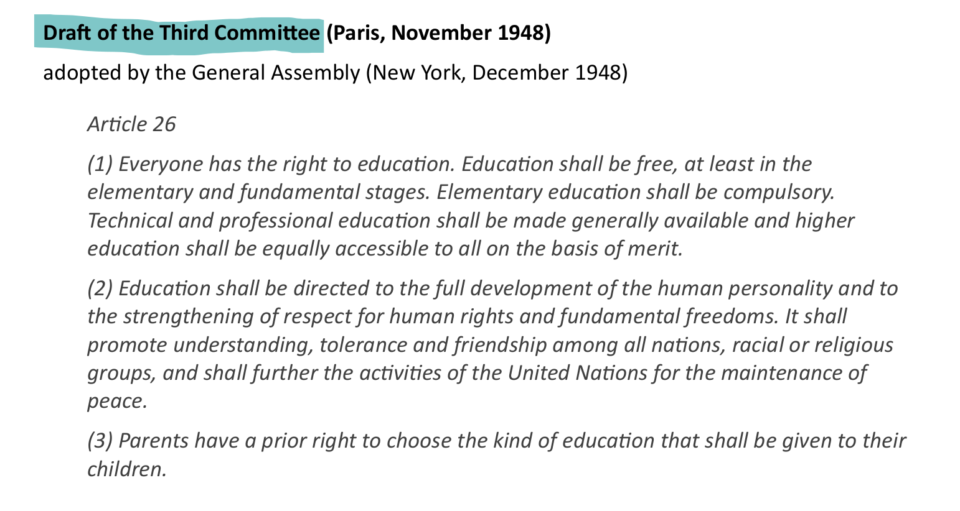

Slide 16
The arguments

Slide 17
Lines of argument
A compulsory right?
A guarantee of access to education
The danger of a state monopoly
The power of the factual

Slide 18
A compulsory right?
Mrs Mehta (India), also objected to the use of the word ‘compulsory’ in a Declaration of Rights and argued that the contradictory concepts of a right and a compulsion could not be reconciled.
Revisiting Article 26 of the Universal Declaration of Human Rights (p. 9)

Slide 19
A compulsory right?
This point was reinforced by Mr Azkoul (Lebanon) who stated that the concept of compulsion was in contradiction with the statement of a right.
Revisiting Article 26 of the Universal Declaration of Human Rights (p. 9)

Slide 20
The danger of a state monopoly
Mr Wilson (UK) also believed that it was dangerous to include the word ‘compulsory’ in the draft Declaration because it could be interpreted as acceptance of the concept of State education.
Revisiting Article 26 of the Universal Declaration of Human Rights (p. 9)

Slide 21
A compulsory right?
…, he suggested that it was ‘difficult to reconcile the statement of a right to education with the notion of the compulsory nature of that education’.
Revisiting Article 26 of the Universal Declaration of Human Rights (p. 9)

Slide 22
A compulsory right?
Immediate support for Mr Wilson’s position was received from Mr Chang (China), who agreed that the word compulsory should be deleted from the draft text.
Revisiting Article 26 of the Universal Declaration of Human Rights (p. 9)

Slide 23
A guarantee of access to education
However, Professor Cassin disagreed and explained that ‘the word “compulsory”...
Revisiting Article 26 of the Universal Declaration of Human Rights (p. 9)

Slide 24
A guarantee of access to education
… should be interpreted to mean that no one (neither the State, nor the family) could prevent the child from receiving elementary education...
Revisiting Article 26 of the Universal Declaration of Human Rights (p. 9)

Slide 25
A guarantee of access to education
… and that the idea of coercion was in no way implied’.
Revisiting Article 26 of the Universal Declaration of Human Rights (p. 9)

Slide 26
A guarantee of access to education
Mr Pavlov (USSR) also believed that ‘the word “compulsory” should not be feared’...
Revisiting Article 26 of the Universal Declaration of Human Rights (p. 9)

Slide 27
A guarantee of access to education
… for it could only work to the advantage of the child whose parents might not understand his vital interests...
Revisiting Article 26 of the Universal Declaration of Human Rights (p. 9)

Slide 28
A guarantee of access to education
… and to the improvement of society, which would receive better-educated individuals’.
Revisiting Article 26 of the Universal Declaration of Human Rights (p. 9)

Slide 29
The power of the factual
Furthermore, free and compulsory education had already established in many countries and so its omission might be viewed as a backward step.
Revisiting Article 26 of the Universal Declaration of Human Rights (p. 9)

Slide 30
The danger of a state monopoly
To help dispel any confusion surrounding the use of the word ’compulsory‘,...
Revisiting Article 26 of the Universal Declaration of Human Rights (p. 9)

Slide 31
The danger of a state monopoly
… Mr Lebar (UNESCO) assured delegates that it did not mean that the state exercised a monopoly over education, ...
Revisiting Article 26 of the Universal Declaration of Human Rights (p. 9)

Slide 32
The danger of a state monopoly
… nor did it infringe the rights of parents to choose the schooling facilities they wished to offer their children.
Revisiting Article 26 of the Universal Declaration of Human Rights (p. 9)

Slide 33
The Chairman put to the vote the deletion of the word “compulsory”...
Revisiting Article 26 of the Universal Declaration of Human Rights (p. 9)

Slide 34
The deletion of the word “compulsory” was rejected by eight votes to seven.
Revisiting Article 26 of the Universal Declaration of Human Rights (p. 9)

Slide 35
The danger of a state monopoly
Mr Watt (Australia) also objected to the mandatory form in which Article 23 laid down that education should be free and compulsory as it implied that no other kind of school would be permitted.
Revisiting Article 26 of the Universal Declaration of Human Rights (p. 9)

Slide 36
The danger of a state monopoly
He therefore requested that some wording should be found which would safeguard the right to choose education at a private school.
Revisiting Article 26 of the Universal Declaration of Human Rights (p. 9)

Slide 37
The danger of a state monopoly
…, Mr Azkoul (Lebanon) reinforced the objection to the word compulsory as it appeared to give the State unrestricted authority over education.
Revisiting Article 26 of the Universal Declaration of Human Rights (p. 11)

Slide 38
A guarantee of access to education
Concerning the issue of compulsion in education, Professor Cassin believed that it would be advisable for elementary education to be compulsory and for this to be explicitly stated, ...
Revisiting Article 26 of the Universal Declaration of Human Rights (p. 12)

Slide 39
A guarantee of access to education
… so that parents would not be able to neglect their duty to their children.
Revisiting Article 26 of the Universal Declaration of Human Rights (p. 9)

Slide 40
A guarantee of access to education
Professor Cassin received immediate support from Mr Pavlov (Union of Soviet Socialist Republics), who argued that:
Revisiting Article 26 of the Universal Declaration of Human Rights (p. 12)

Slide 41
A guarantee of access to education
A child had an absolute right to education, independently of the wishes of its parents. Education should be compulsory because a child could not itself claim the right, as it had no strength to defend it.
Revisiting Article 26 of the Universal Declaration of Human Rights (p. 12)

Slide 42
A guarantee of access to education
The word “compulsory” was therefore necessary in the body of Article 23.
Revisiting Article 26 of the Universal Declaration of Human Rights (p. 12)

Slide 43
A guarantee of access to education
For Mr Pavlov (USSR), the ‘obligations’ implied by the term ‘compulsory’ applied to society and the State:
The writing of Article 26 of the Universal Declaration of Human Rights (p. 99)

Slide 44
A guarantee of access to education
The concept contained in [the word “compulsory”] was closely linked with the concept of the right to education.
The writing of Article 26 of the Universal Declaration of Human Rights (p. 99)

Slide 45
A guarantee of access to education
It presupposed that the obligations of society correspond to the rights of every human being to free education.
The writing of Article 26 of the Universal Declaration of Human Rights (p. 99)

Slide 46
A guarantee of access to education
The State had the obligation to furnish opportunities for education to everyone and to ensure that no one could be deprived of these opportunities.
The writing of Article 26 of the Universal Declaration of Human Rights (p. 99)

Slide 47
The danger of a state monopoly
Following the Commission’s vote in favour of including the word ‘compulsory’, ...
The writing of Article 26 of the Universal Declaration of Human Rights (p. 104)

Slide 48
The danger of a state monopoly
…, Mr Malik (Lebanon) expressed the view that the inclusion of this word could ‘be interpreted as making it imperative for children to be sent to schools designated by the State’.
The writing of Article 26 of the Universal Declaration of Human Rights (p. 104)

Slide 49
The danger of a state monopoly
He felt it necessary, therefore, to propose an amendment adding a phrase ‘designed to guarantee the right of the family to determine the education of its children, but not to prevent such education’.
The writing of Article 26 of the Universal Declaration of Human Rights (p. 105)

Slide 50
The power of the factual
In support of Article 27, the Commission was reminded that free and compulsory education had already been established in the constitutions of forty countries.
Revisiting Article 26 of the Universal Declaration of Human Rights (p. 7)

Slide 51
The power of the factual
… the representative of the Netherlands […] disarmingly declared that ‘he had no objection to compulsory education since that system had been in force in his country for more than fifty years’.
The writing of Article 26 of the Universal Declaration of Human Rights (p. 105)

Slide 52
None of the persons who contributed to the formulation of Article 26 UDHR expressed the view that children should be forced to attend school against their will.

